Slide 1
Data Mining
Model Validation
模型验证
Qin Zhang
qinzhang@szu.edu.cn

Slide 2
Outline
Evaluation Metrics
Underfiting & Overfitting
Model Validation

Slide 3
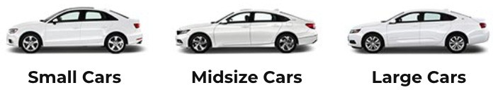
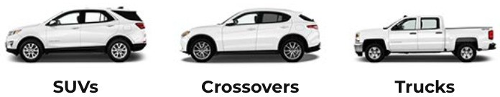
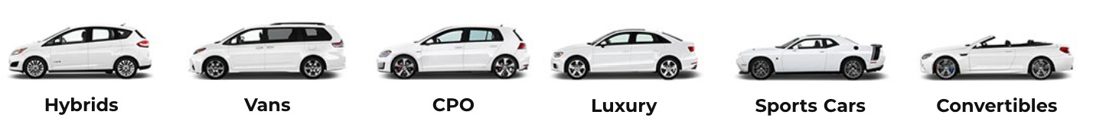
Model Metrics
Loss measures how good the model in predicting the outcome in supervised learning
Other metrics to evaluate the model performance
Model specific: e.g. accuracy for classification, MAP for object detection
Business specific: e.g. revenue(收益), inference latency
We select models by multiple metrics
Just like how you choose cars

Slide 4
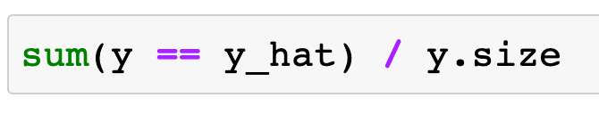
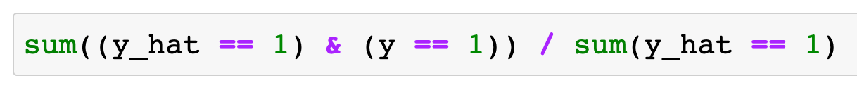
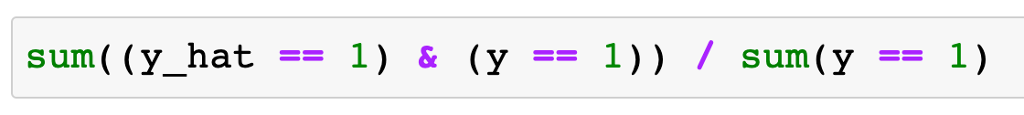
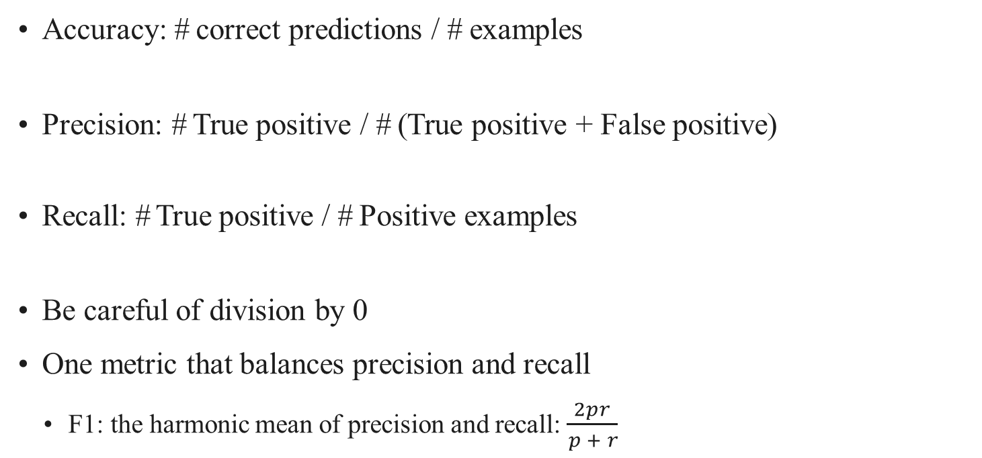
Metrics for Binary Classification
Accuracy: # correct predictions / # examples
Precision: # True positive / # (True positive + False positive)
Recall: # True positive / # Positive examples
Be careful of division by 0
One metric that balances precision and recall
F1: the harmonic mean of precision and recall: $\frac{2pr}{ p + r}$

Slide 5
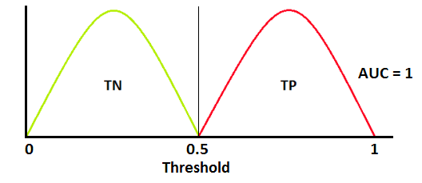
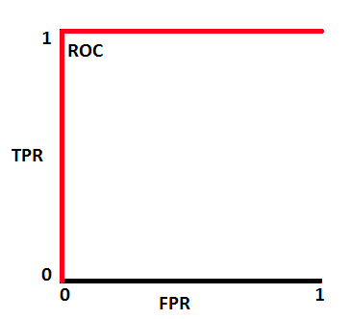
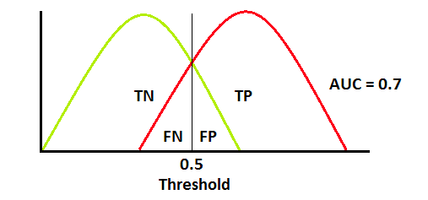
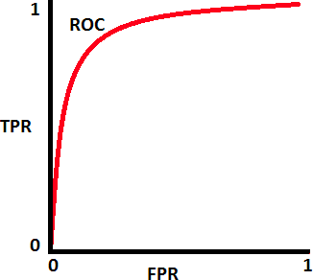
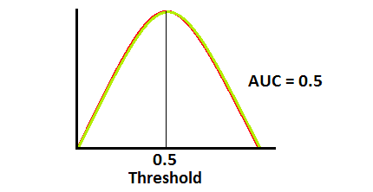
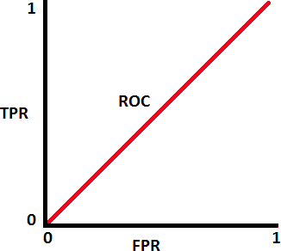
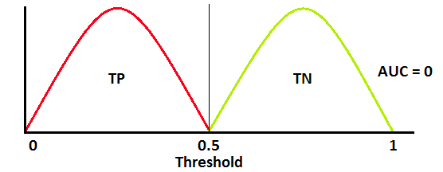
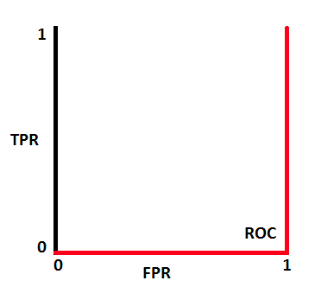
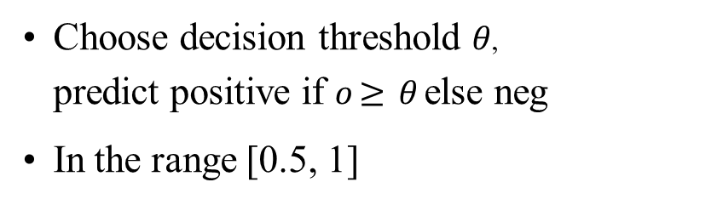
AUC—ROC(Receiver Operating Characteristics)
Measures how well the model can separate the two classes
Choose decision threshold $θ$,
predict positive if $o≥ θ$else neg
In the range [0.5, 1]
Distribution of output o
Ideal separation
# True Pos predictions
ROC curve
TPR=
# pos examples
Non separable
_{FPR=} # False Pos
# neg examples
predictions

Slide 6



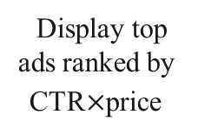
Case Study: Displaying Ads
Ads is one major revenue source for Internet companies
Query / page
Estimate click through rate (CTR)
Display top ads ranked by
CTR$×$price
Retrieve related ads
A binary classification problem

Slide 7
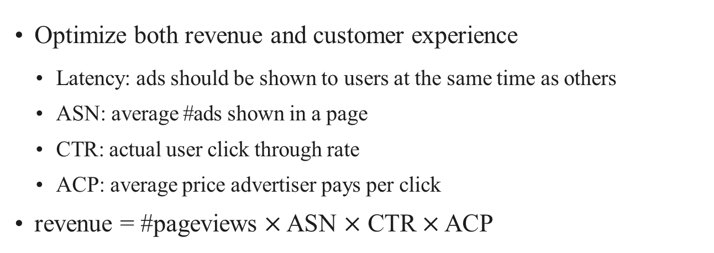
Business Metrics for Displaying Ads
Optimize both revenue and customer experience
Latency: ads should be shown to users at the same time as others
ASN: average #ads shown in a page
CTR: actual user click through rate
ACP: average price advertiser pays per click
revenue = #pageviews $×$ ASN $×$ CTR $×$ ACP
Platform company
Matters to whom
User
Advertiser

Slide 8
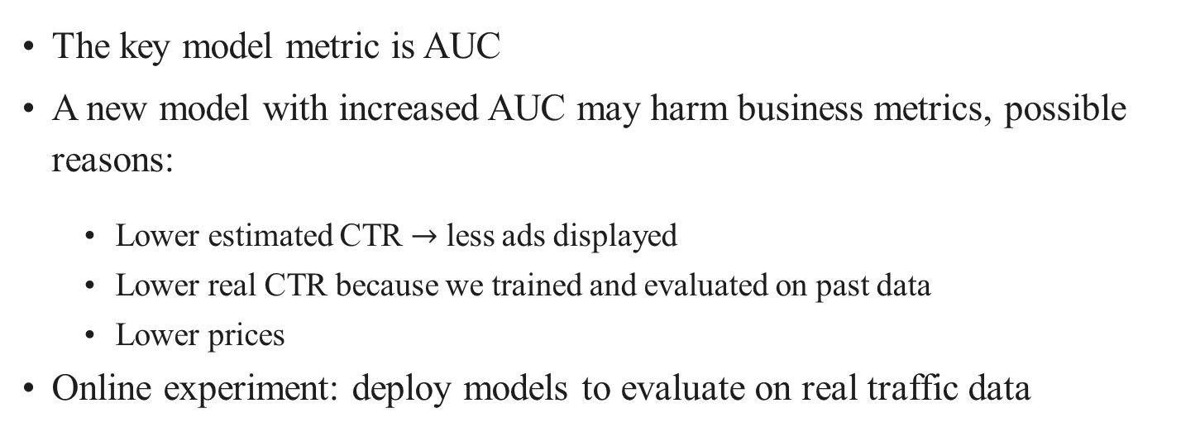
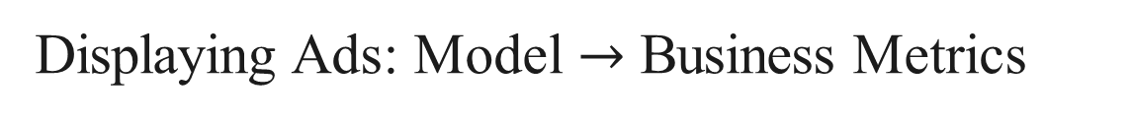
Displaying Ads: Model $→$ Business Metrics
The key model metric is AUC
A new model with increased AUC may harm business metrics, possible reasons:
Lower estimated CTR $→$ less ads displayed
Lower real CTR because we trained and evaluated on past data
Lower prices
Online experiment: deploy models to evaluate on real traffic data

Slide 9
Summary
We evaluate models with multiple metrics
Model metrics evaluate model performance on examples
E.g. accuracy, precision, recall, F1, AUC for classification models
Business metrics measure how models impact the product

Slide 10
Outline
Evaluation Metrics
Underfiting & Overfitting
Model Validation

Slide 11
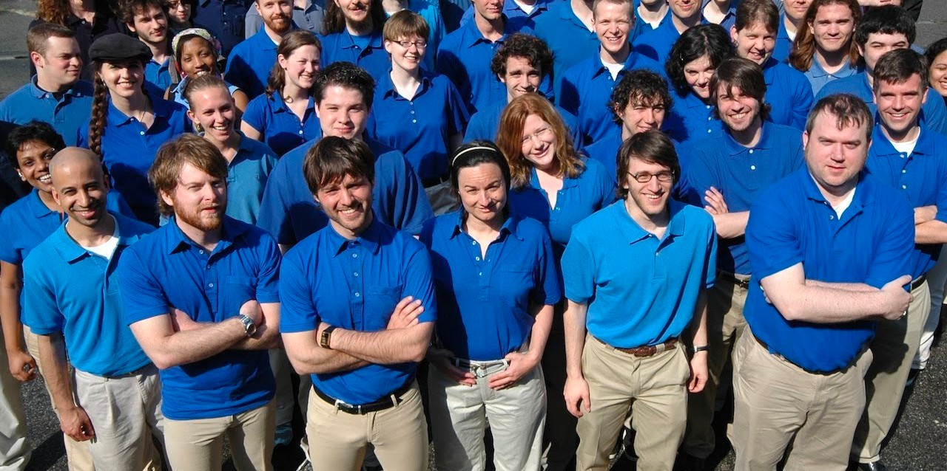
Who will Repay Their Loans?
A lender hires you to investigate who will repay their loans
You are given all information about the 100 applicants
5 defaulted(违约) within 3 years
A Surprising Finding?!
All 5 people who defaulted wore blue shirts during interviews
Your model leverages this strong signal as well

Slide 12
Underfitting and Overfitting
Training error: model error on the training data
Generalization error: model error on new data
Training error
v
 | Low | High
Low | Good | Bug?
High | Overfitting | Underfitting
Generalization error

Slide 13
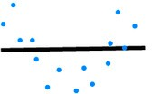
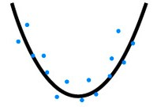
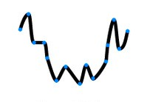
Data and Model Complexity
Underfitting
Data complexity
 | Low | High
Low | Normal | Underfitting
High | Overfitting | Normal
v
Normal
Model complexity
Overfitting
Image credit: hackernoon.com

Slide 14
Model Complexity
The capacity of a set of function to fit data points
In ML, model complexity usually refers to:
The number of learnable parameters
The value range for those parameters
It’s hard to compare between different types of ML models
E.g. trees vs neural network
More precisely measure of complexity: VC dimension
VC dim for classification model:
the maximum number of examples the model can shatter

Slide 15
Model Complexity
Optimal model
Generalization error
Over fitting
Error
Under fitting
Training error
Model complexity

Slide 16
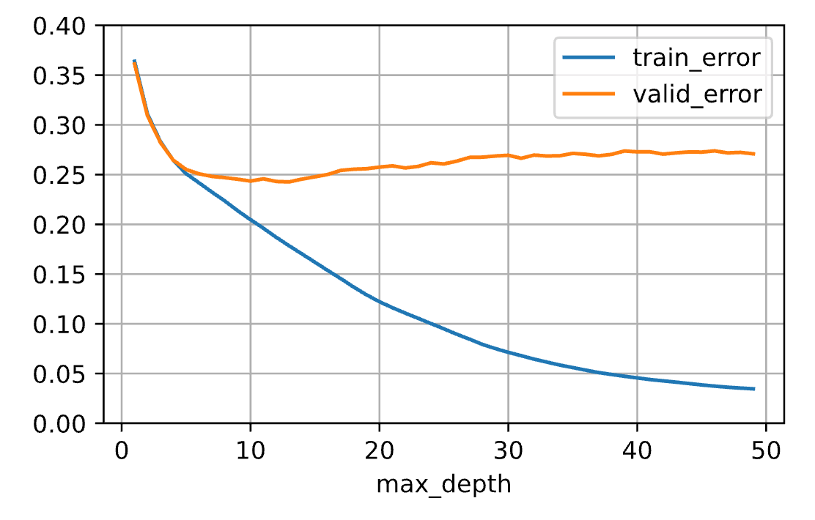
Model Complexity Example: Decision Tree
Underfitting
The tree size can be controlled by the number of levels
Use scikit-learn
DecisionTreeRegressor(max_depth
=n) on house sales data
Overfitting

Slide 17
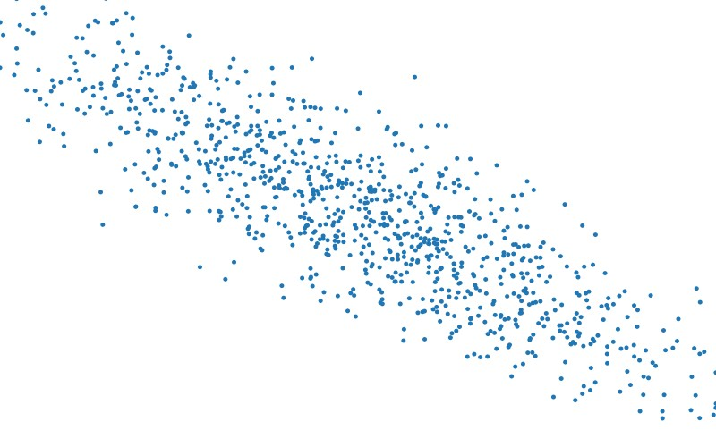

Data Complexity
Multiple factors matters
# of examples
# of features in each example
the separability（可分离性） of the classes
Again, hard to compare among very different data
E.g a char vs a pixel
More precisely, Kolmogorov complexity(柯尔莫哥洛夫复杂度)
A data is simple if it can be generated by a short program

Slide 18
Model Complexity vs Data Complexity
Complex models need more data
Generalization
error
Simple model
(e.g. linear)
Complex model
(e.g. deep neural networks)
Data complexity

Slide 19
Model Selection
Pick a model with a proper complexity for your data
Minimize the generalization error
Also consider business metrics
Pick up a model family, then select proper hyper-parameters
Trees: #trees, maximal depths
Neural networks: architecture, depth (#layers), width (#hidden units), regularizations

Slide 20
Summary
We care about generalization error
Model complexity: the ability to fit various functions
Data complexity: the richness of information
Model selection: match model and data complexities

Slide 21
Outline
Evaluation Metrics
Underfiting & Overfitting
Model Validation

Slide 22
Generalization Error
Approximated by the error on a holdout test dataset, which has never been seen by the model and can be only used once
Your midterm exam score
The final price of a pending house sale
Dataset used in private leaderboard in Kaggle
Validation dataset:
Often a subset of the dataset, not used for model training
Can be used multiple times for hyper param tuning
“test error” usually refers to error on “validation” dataset

Slide 23
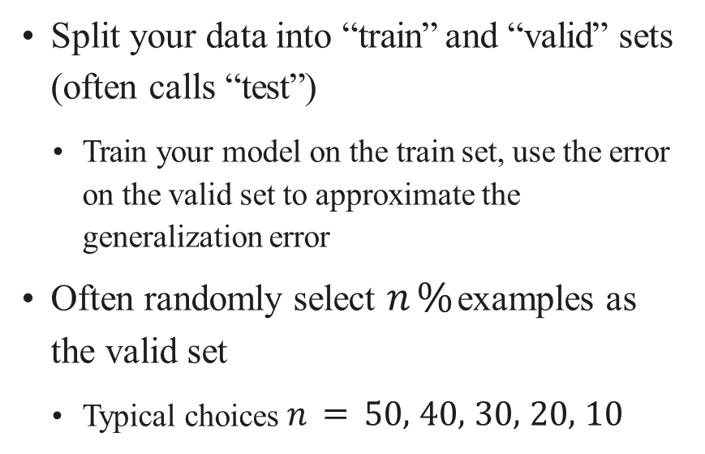
Hold Out Validation
Split your data into “train” and “valid” sets (often calls “test”)
Train your model on the train set, use the error on the valid set to approximate the generalization error
Often randomly select $n \%$ examples as the valid set
Typical choices $n=50, 40, 30, 20, 10$
Train
Valid

Slide 24
Split non I.I.D. data
Random data splitting may lead to underestimate of generalization error
Sequential data
e.g. house sales, stock prices
Valid set should not overlap with train set in time
Examples are highly clustered
e.g. photos of the same person, clips of the same video
Split clusters instead of examples
Highly imbalanced label classes
Sample more from minor classes

Slide 25
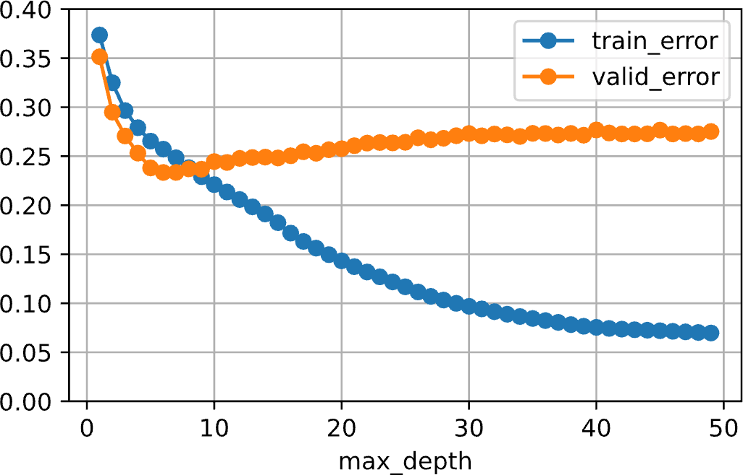
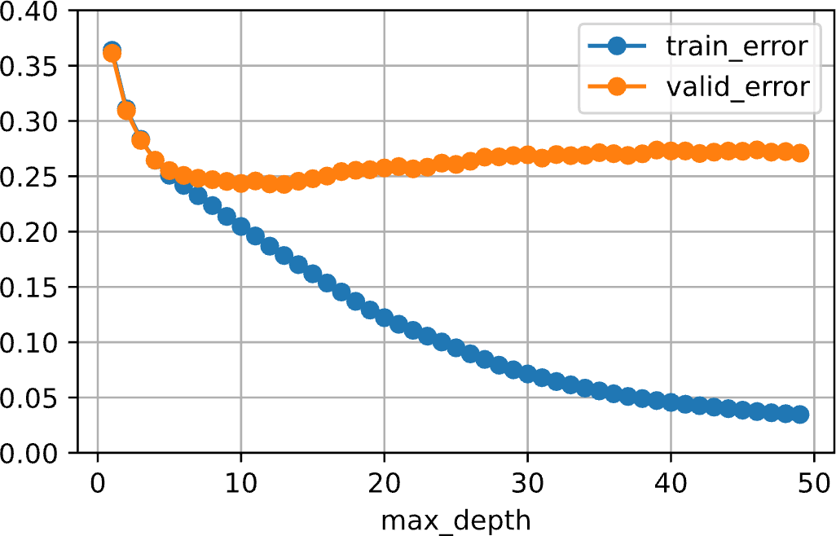
Case Study on House Sales Data
Split by 50%, test both random and sequential splittings
Decision tree
Linear regression
Sequential, best d = 6
Random, best d = 13
Split | Train | Valid
Random | 0.126 | 0.136
Sequential | 0.109 | 995901.7

Slide 26
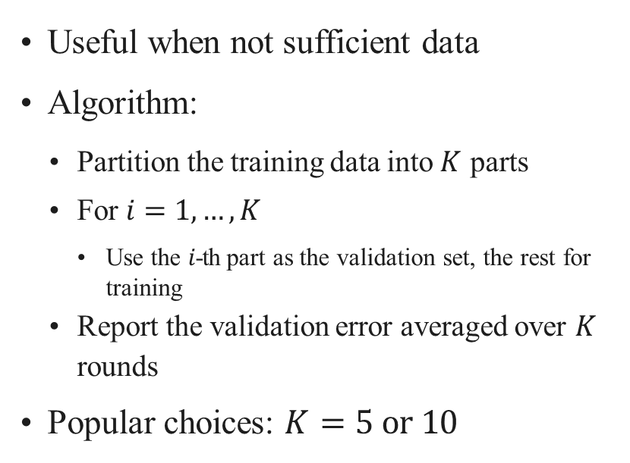
K-fold Cross Validation
Useful when not sufficient data
Algorithm:
Partition the training data into $K$ parts
For $i=1, …, K$
Use the $i$-th part as the validation set, the rest for training
Report the validation error averaged over $K$ rounds
Popular choices: $K=5 or 10$
Data
Fold 1:
Valid | Train | Train
Fold 2:
Train | Valid
 |  | Train
Fold 3:
Train | Train | Valid

Slide 27
Common Mistakes
If your ML model performance is too good to be true, very likely there is a bug, and contaminated（受污染的）valid set is the #1 reason.
Valid set has duplicated(重复的) examples from train set
Often happens when integrating multiple datasets
Scrape images from search engine to evaluate models trained on ImageNet
Information leaking from train set to valid set
Often happens for non I.I.D data
use future to predict past, see a person’s face before
Excessive use(过度使用) of valid set for hyper param tuning is cheating

Slide 28
Summary
The test data is used once to evaluate your model
One can hold out a validation set from the training data to estimate the test data
You can use valid set multiple times for model selections and hyper param tuning
Validation data should be close to the test data
Improper valid set is a common mistake that lead to over estimate of the model performance

